Slide 1
Machine learning
Regent College London
SWE6204

Slide 2
Machine learning
SWE6204

Slide 3

Machine learning
Introduction on Python and Anaconda Navigator configuration

Slide 4
Module 1 – Introduction on Python and Anaconda Navigator configuration

Slide 5
Download and install anaconda
Open the website https://www.anaconda.com/distribution/
Select your operating system and download the Python 3.x version.
Install the package as instructed on the website.

Slide 6
Tutorial & labs
Please enter the Tutorial folder and open "Tutorial xxxxxx.ipynb"
Read the tutorial using Jupyter notebook and complete the exercises provided. Instructions are in the Jupyter notebook with the sample code.

Slide 7
Using the jupyter notebook
You edit the content of a cell by selecting it and entering edit mode by pressing ENTER
You can exit edit mode by pressing ESC
You can execute the content of a cell by pressing ALT+ENTER
To create a new cell you can use A (cell create above) or B (cell created below)
Press D twice to delete a cell

Slide 8
Installing python on your pc
You can install Python and the required dependencies in your own computer by following the instructions on the next slides.

Slide 9
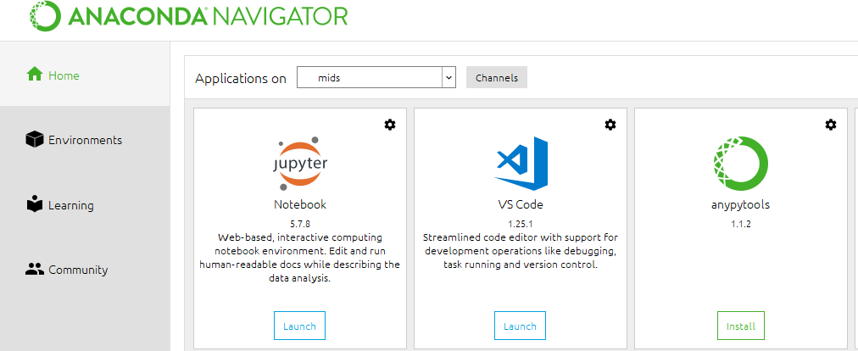
Using anaconda
Open the Anaconda Navigator
Launch the Jupyter Notebook
app
Use the online notebook app (open within the browser) to navigate to the desktop folder where the files were extracted.

Slide 10
Introduction to python coding
Please open the session2 .ipynb file in Anaconda

Slide 11
+44 (0)207 016 8000
info@rcl.ac.uk

